Slide 1
Welcome Back!
English 12 Honors
Mrs. Stansbury
Find your seat that corresponds with the number on your card
On a sheet of paper, tell me your plans for after high school

Slide 2
Materials
Planner
Vocabulary books
Lit/Lang books

Slide 3
How was your summer?
Raise your hand if you…
Worked over summer break
Left the state
Went on vacation
Went to Holiday World
Read The Outliers☺

Slide 4
Summer Reading
You should have completed the 4 online quizzes by now
If you had any problems, write them down on a piece of paper with your name and class period
In-class essay

Slide 5
About Me…Mrs. Stansbury
7th year of teaching
Went to IU Southeast for Bachelor’s and Master’s degree
Teach a graduate class at IUS

Slide 6
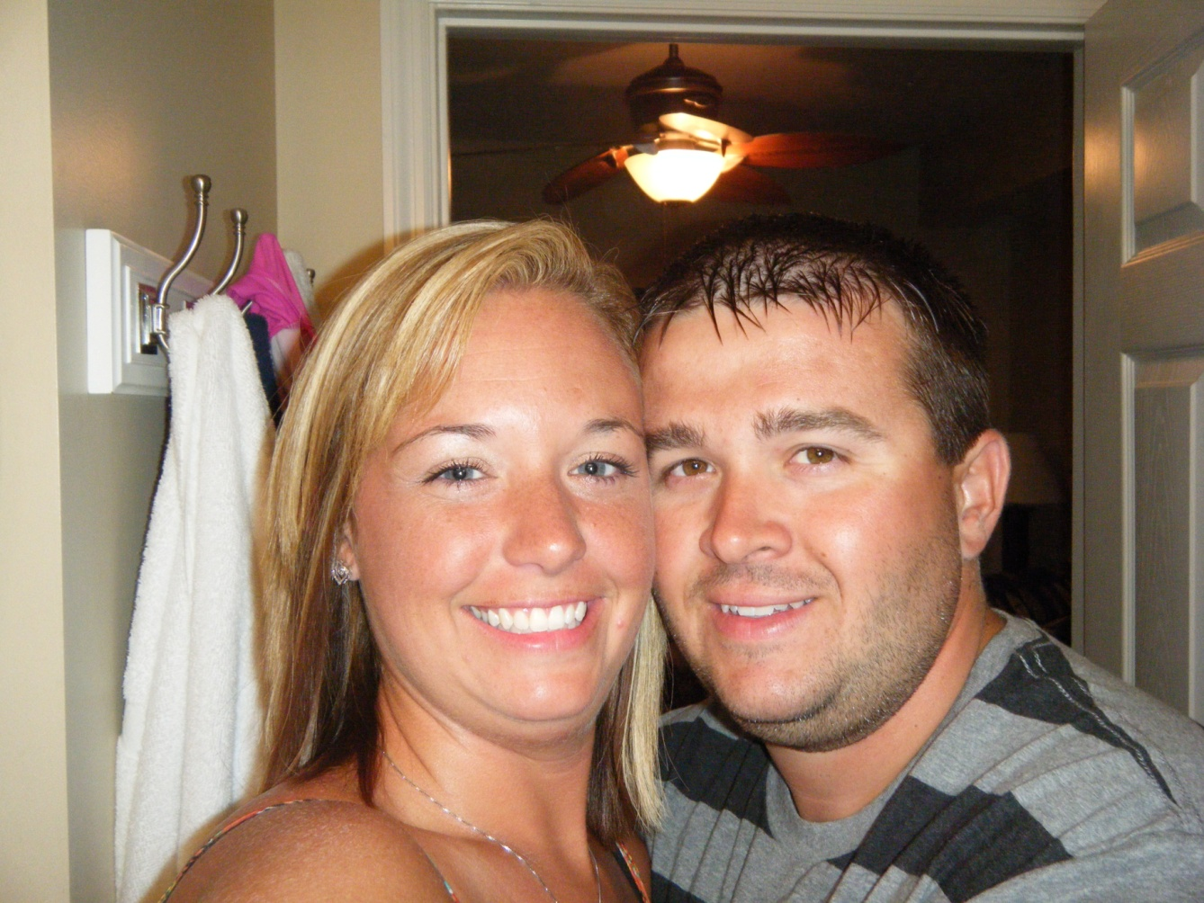
About Me…Mrs. Stansbury
Husband: Daniel

Slide 7
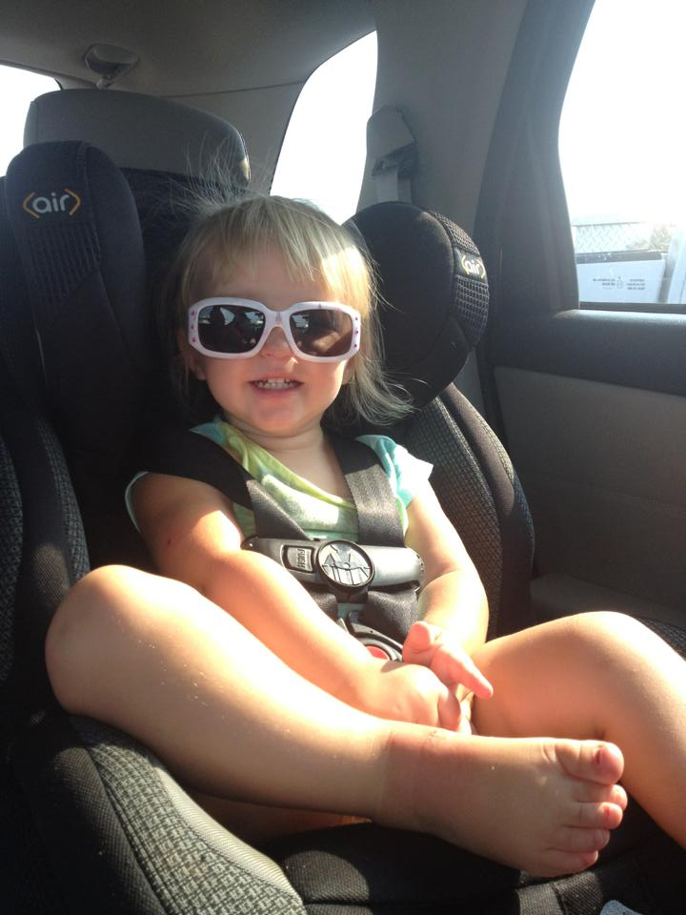
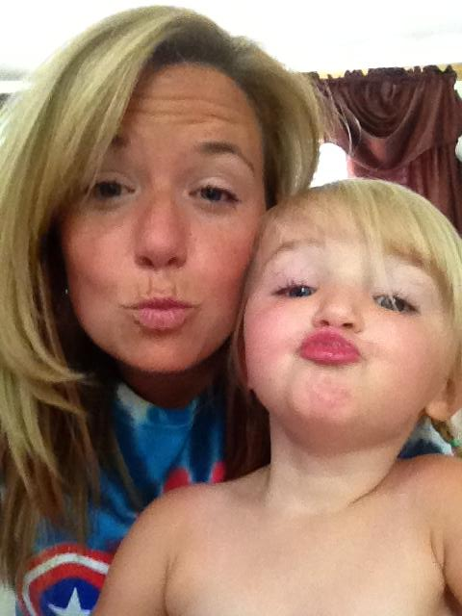
About Me…Mrs. Stansbury
My life revolves around…Emily

Slide 8
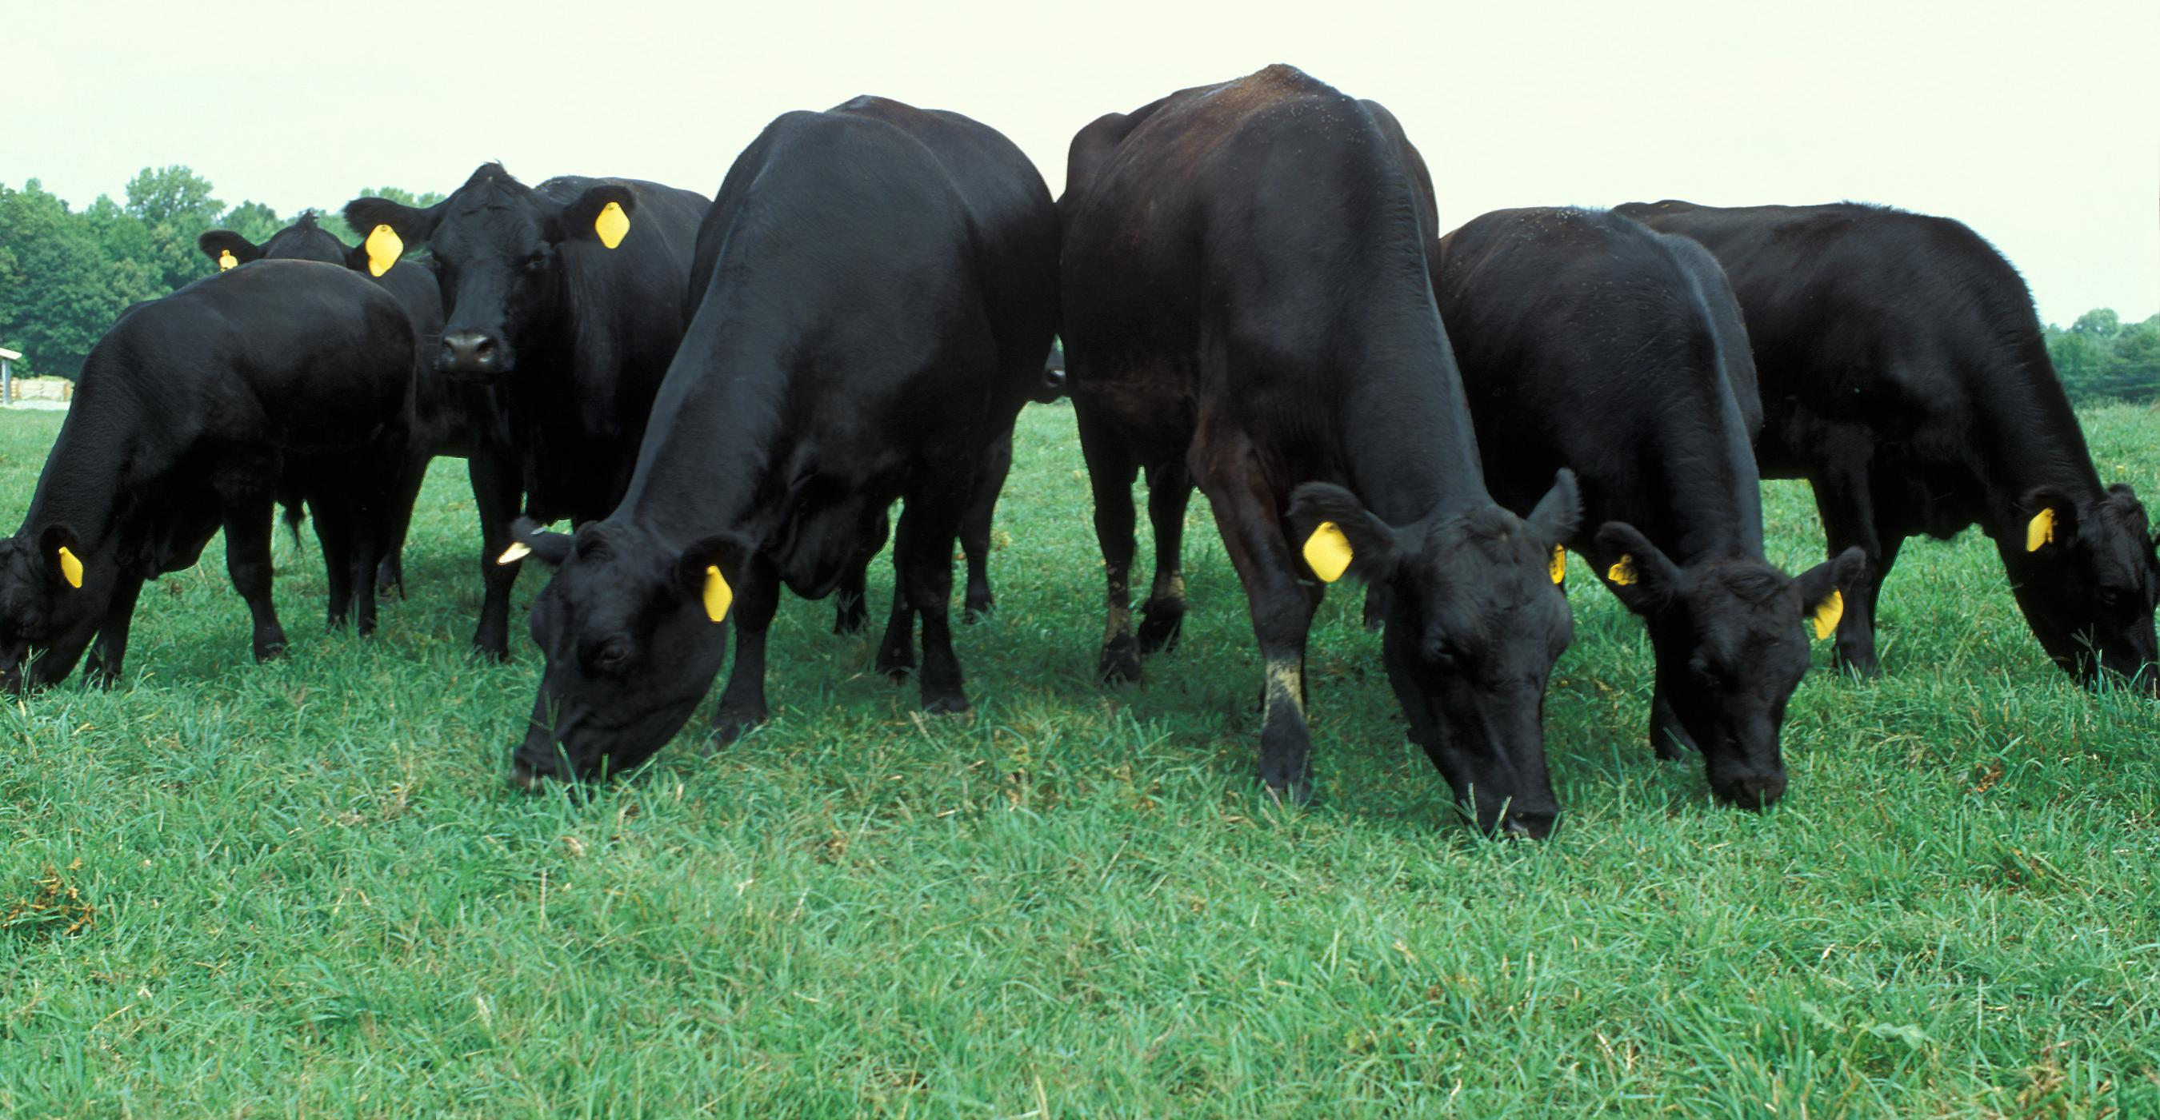
About Me…Mrs. Stansbury
Live on a cattle farm in Corydon

Slide 9
Class Syllabus
An education isn't how much you have committed to memory, or even how much you know. It's being able to differentiate between what you know and what you don't.
Anatole France

Slide 10
Learning is not attained by chance, it must be sought for with ardor and diligence.
Abigail Adams

Slide 11
English 12 Honors Expectations
College preparatory course
Material will be covered at an honors level
Graded on honors standards
My job this year is to prepare you for college-level work
IMPORTANT: the expectations for this class are extremely high

Slide 12
Required Materials
3 ring binder with pockets
Set of 5 dividers-see Syllabus for tab labels
Loose leaf paper or notebook
Composition notebook
Vocabulary Book
Must have supplies by Monday

Slide 13
Evaluation/Grading
Point-total basis
No late assignments will be accepted
Extra credit is generally not given

Slide 14
Student Responsibilities
Participation and discussion points will be awarded
You should be present on exam days. If you are absent, it is your responsibility to schedule a make-up test.
Grades are your responsibility. Check INOW to keep track of your grade.

Slide 15
Senior Research Paper
Historical investigation of early British history
IT IS IMPOSSIBLE TO PASS THIS CLASS WITHOUT COMPLETING THE PAPER
Paper is due Friday, October 4th

Slide 16
Remind 101
Use to text reminders
Sign-up tonight

Slide 17
Class webpage
Updated weekly for daily agenda
Class PowerPoints and all handouts will be available

Slide 18
Contacting me
Feel free to contact me at anytime
Cell phone is the best means of communication

Slide 19
Tonight’s Homework
Read the Valedictorian Speech-come ready to discuss the purpose of education tomorrow in regards to the speech
Read the introduction to The Alchemist
Answer the following question: What are the 4 obstacles to achieving a dream?

