Slide 1
English 11H Week of September 16th

Slide 2
Monday, 9/16
SSR
Run-on Practice
Article, Equality

Slide 3
Tuesday, 9/17
Lesson 5 Quiz
Book talks
Go over run-on practice

Slide 4
Wednesday, 9/18
SSR/Book Talks
If you still need to sign-up for a book talk, write your name, period and how many you need to sign-up for. I will try to work them into the schedule.
The Crucible…Background PowerPoint, Author

Slide 5
The Crucible
By: Arthur Miller
(1915-2005)

Slide 6
Video Clip…
In Samuel Parris' home, a servant, Tituba, enjoyed entertaining the Parris' daughter and her friends with stories from her native country of Barbados, and she even demonstrated voodoo tricks. The girls began acting strangely, and when a doctor examined them and found no physical evidence of ill health, he declared they were under the evil hand of witchcraft.
The Beginnings of Hysteria

Slide 7
What does “crucible” mean?
a vessel of a very refractory material (as porcelain) used for melting and calcining a substance that requires a high degree of heat
a severe test
a place or situation in which concentrated forces interact to cause or influence, change or development

Slide 8
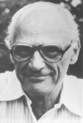
Arthur Miller
Born in New York City, Oct. 17, 1915.
Miller began writing plays while a student at the University of Michigan as a way to pay for his tuition.
Graduated with a degree in journalism.
Wrote and produced five plays during college career.
Married three times
Two daughters, one son.

Slide 9
Background of author
His father, Isidore Miller, was a ladies-wear manufacturer and shopkeeper who was ruined in the depression. The sudden change in fortune had a strong influence on Miller.
To study journalism he entered the University of Michigan in 1934, where he won awards for playwriting.

Slide 10
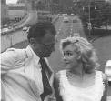
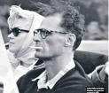
AM and MM
Miller married the motion-picture actress Marilyn Monroe in 1956; they divorced in 1961.

Slide 11
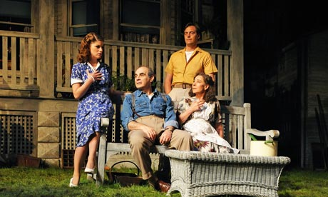
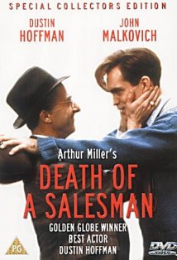
Plays
His first successes--All My Sons (1947) and Death of a Salesman (1949).
Miller condemned the American ideal of prosperity on the grounds that few can pursue it without making dangerous moral compromises.

Slide 12
Miller and HUAC
Investigated for possible associations with the Communist party from 1953 to 1955
In 1956, he was called to testify before the House Committee on Un-American Activities (HUAC).
Only attended meetings looking to advocate social justice and equality
When brought before the committee, he refused to name any other attendees.

Slide 13
Miller and HUAC (cont.)
Found guilty of contempt
Later released

Slide 14
Miller and HUAC (cont.)
Senator McCarthy accused many people— actors, writers, people in media, people in the military — of being Communists.
He held hearings where people were commanded to give names of other Communists in order for leniency.
People were afraid they might be named as Communists, and it was called the Red Scare. (‘Red’ was a word used for a Communist.)

Slide 15
McCarthyism
McCarthyism came to mean false charges of disloyalty.
In September 1950, goaded by McCarthy, Congress passed the McCarran Internal Security Act, which established a Subversive Activities Control Board to monitor Communist influence in the United States.

Slide 16
McCarthyism
McCarthy’s influence continued until 1954, when the Senate censured him for abusing his colleagues. His career collapsed.
Fears of subversion continued. Communities banned books; teachers, academics, civil servants, and entertainers lost jobs; unwarranted attacks ruined lives.

Slide 17
Industry workers had three options…
These industry workers called before the HUAC to testify about their ties to communism knew they had three options.
They could claim they were not and never had been members of the Communist Party (this would have meant perjuring themselves)
They could admit or claim membership and then be forced to name other members (and this would have meant losing their jobs both because of their former membership and their dubious position as informers)
Or they could refuse to answer any questions (which is the choice they made).

Slide 18
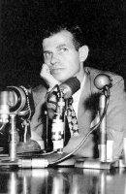
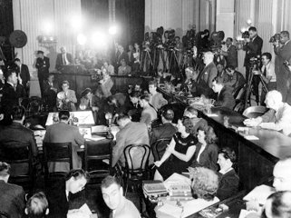
The HUAC and Hollywood
HUAC investigated communism within Hollywood, calling a number of playwrights, directors and actors known for left-wing views to testify.
Some of these, including film director Elia Kazan, testified for the committee to avoid prison sentences.
The Hollywood Ten, a group of entertainers, refused to testify and were convicted of contempt and sentenced to up to one year in prison.

Slide 19
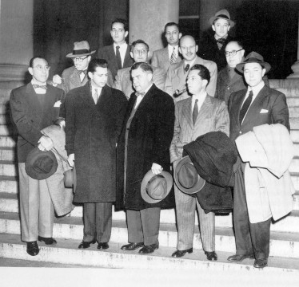
Blacklisting
Over 300 entertainers were placed on a blacklist for possible communist views and were thus forbidden to work for major Hollywood studios (many of these were writers who worked under pseudonyms).
Arthur Miller was one of those blacklisted.

Slide 20
The Red Scare
A time of paranoia and hysteria over communism.
Many government officials were involved or accused.
Many writers, actors, and directors lost their jobs.
Many named names to save their own careers.

Slide 21
Homework
Read the Overture
Pages 1216-1218

Slide 22
Thursday, 9/19
SAT Practice
The Crucible Background PowerPoint, Salem Witchtrials

Slide 23
Critical Reading… SAT…
When Susan, the manager of the clothing store where Nathan shopped, ------- his complaints, he became so ------- that he resolved to take his business to a competing retailer.
exaggerated... exhilarated
disregarded… gratified
heeded… despondent
ridiculed… unscrupulous
trivialized… exasperated

Slide 24
Answer…
E. trivialized… exasperated
A seven on the scale
Only 39% of FC students answered correctly

Slide 25
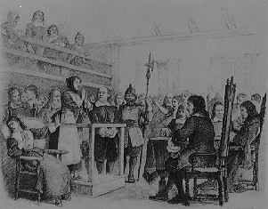
Salem, 1692

Slide 26
The Puritans in Salem, 1692
In the 1600s, Puritans settled on the East coast of the United States.
They brought with them the hope of religious freedom, but instead became embroiled in hysteria over the existence of witches.
They had been persecuted in their native England, but they created a theocracy and eventually persecuted others.

Slide 27
Theocracy-
government by god: government by a god or by priests
community governed by god: a community governed by a god or priests
Greek roots:
Theo is a root meaning “God”
Cracy is a root meaning “government”
Can you think of any current-day governments that are run by a theocracy?

Slide 28
Characteristics of those accused…
The accused…
1. Most of those accused of being witches were women.
2. Many were healers, and used plants to heal people.
What would we call these people today?
3. Many were without family, and this made them easy targets.
4. They were people who did not fit in with the mainstream for some reason.

Slide 29
The Puritans in Salem, 1692
One of the ways most witches were accused was with the use of “spectral evidence.”
What do we call this evidence today?
Example: If someone said they had seen the accused with the devil in a dream, or that the accused had visited them in the night, or had hurt them, it was taken as evidence that the devil was at work.

Slide 30
Why did it happen?
1. It began as a way for the oppressed girls to avoid being punished.
2. It then became an ideal way to get revenge on anyone whom you disliked.
3. People started accusing their neighbors of being witches so they could steal their farmland.
4. People accused others of being witches if they wanted to steal their husbands or wives or possessions.
http://www.law.umkc.edu/faculty/projects/ftrials/salem/witchhistory.html

Slide 31
The Salem Witch Trials
In 1692, twenty were executed; 150 were jailed.
The Puritan culture attributed its hardships to the Devil.
Several girls in the town began to have seizures and lapses of unconsciousness after seeking Tituba, a slave from Barbados, for fortunetelling.

Slide 32
The Salem Witch Trials (cont.)
Tituba and two elderly women were accused at first; by the end, many of the community’s most prominent citizens were accused.
Overall nineteen were hanged, four accused died in prison, and one was pressed to death.
In 1706, Ann Putnam signs a letter of apology.

Slide 33
How did it start?
1. In 1692, several girls in the village of Salem, Massachusetts became intrigued when a West Indian servant told them stories of magic and voodoo from her native land.
2. Bored and restricted by the oppressive Puritan life, the girls slipped into the woods one night and “conjured” love charms and hexes.
3. One girl, Betty Parris, slipped into unconsciousness when her father caught them. She wouldn’t wake up, and this started the discussion of witchcraft. To avoid punishment, the girls created the story of the “witches” who made them dance and conjure the spells.

Slide 34
How did it start?
1. Those accused of being witches were most often found guilty. Sometimes they were sentenced to be tied to a rock dunked in a pond, and if they sank, they were declared innocent. Innocent. If they somehow survived the dunking, they were obviously witches, and they were executed.
2. Most of those found guilty of witchcraft were hung.
3. One man was pressed to death with rocks because he refused to plead guilty or innocent, insuring that his sons still inherited his lands.

Slide 35
How Did It End?
Why the Hysteria Ended…
1. Doubts grow when respected citizens are convicted and executed. -------Rebecca Nurse (jury first acquits, then told to reconsider) -------George Burroughs (recites Lord's Prayer perfectly at hanging) -------Giles Corey (81-year-old is pressed to death)
2. Accusations of witchcraft include the powerful and well-connected. -------Wife of Governor Phips -------Mary & Philip English (and others)
3. The educated elite of Boston pressure Gov. Phips to exclude spectral evidence. -------Rev. Samuel Willard and others -------Increase Mather points out the Devil could take the shape of an innocent person: "It were better that 10 suspected witches should escape than one innocent person should be condemned.“
4. Gov. Phips bars spectral evidence and disbands the Court of Oyer and Terminer.

Slide 36
So, What’s the connection?
Miller wrote The Crucible as a metaphor for the Red Scare in the 1950’s.
He felt there was a “witch-hunt” within the government and beyond.
Like the witch trials, it was easier to admit guilt than maintain innocence.

Slide 37
Define…
In your own words define witch-hunt.
Provide examples of contemporary witch-hunts.
What makes your example a witch-hunt?

Slide 38
witch-hunt
Searching out and harassing dissenters
The act of tormenting by continued persistent attacks and criticism
McCarthyism - unscrupulously accusing people of disloyalty (as by saying they were Communists)

Slide 39
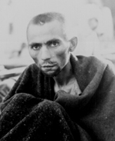
20th Century Witch Hunts
The Holocaust

Slide 40
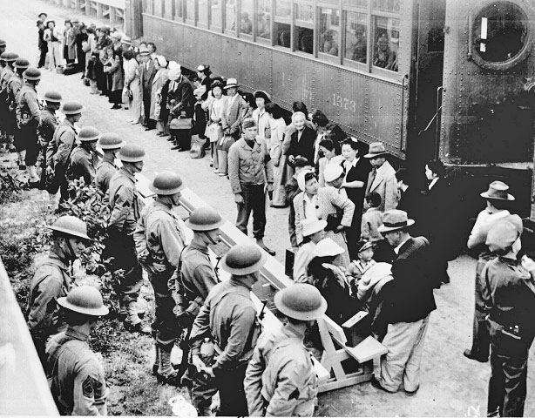
20th Century Witch Hunts
Japanese-American Internment Camps

Slide 41
20th Century Witch Hunts: Racial Profiling
African Americans
Native Americans
Arab/Middle-Eastern decent

Slide 42
Themes-
Be aware of false accusations
Rumors do harm
Integrity is key
Not all things are as they seem

Slide 43
Literary Terms
Act I
Dialogue- refers to the words characters’ speak. Dialogue helps advance the plot and reveals characters personalities.
Stage Directions- usually indicate where a scene takes place, what should the scene look like, and how a characters should move and speak.
Dramatic Expression- conveys critical information about play’s settings, props, characters, historical and social context.
Character’s Motives-A character’s reason for behaving as they do. These are the driving forces behind human nature.

Slide 44
Non-fiction article: Witch Hunt Due next Thursday (9/26) in class
You wind need to find a non-fiction article on current day witch-hunts in the world. Answer the following questions regarding the article. Print out the article.
Title of article:
Author’s name:
Source:
Provide me a brief summary of the witch-hunt. Where it occurred, why it happened, who was involved, and resolution regarding the case.

Slide 45
Homework
Read the Overture
Pages 1216-1218

Slide 46
Friday, 9/19
SSR/Book Talks
Pick Parts
Begin reading

